Slide 1
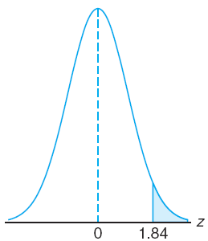
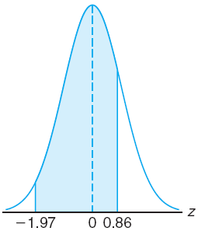
Chapter 6.3
Areas Under the Normal Curve
Area Under the Normal Curve
Given a standard normal distribution, find the area under the curve that lies (a) to the right of z = 1.84 and (b) between z = –1.97 and z = 0.86.

Slide 2
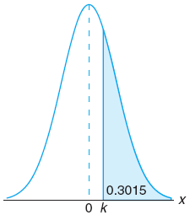
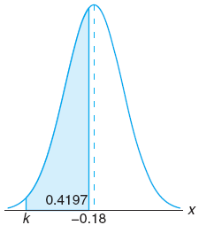
Chapter 6.3
Areas Under the Normal Curve
Area Under the Normal Curve
Given a standard normal distribution, find the value of k such that (a) P ( Z > k ) = 0.3015, and (b) P ( k < Z < –0.18 ) = 0.4197.

Slide 3
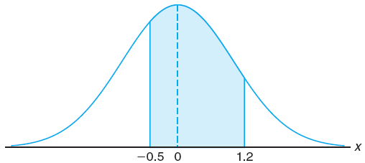
Chapter 6.3
Areas Under the Normal Curve
Area Under the Normal Curve
Given a random variable X having a normal distribution with μ = 50 and σ = 10, find the probability that X assumes a value between 45 and 62.

Slide 4
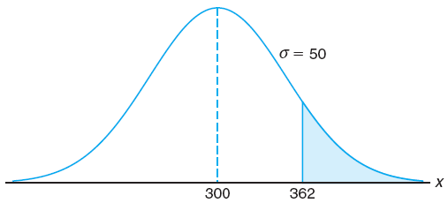
Chapter 6.3
Areas Under the Normal Curve
Area Under the Normal Curve
Given that X has a normal distribution with μ = 300 and σ = 50, find the probability that X assumes a value greater than 362.

Slide 5
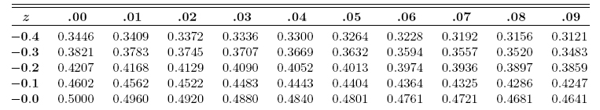
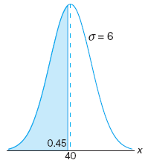
Chapter 6.3
Areas Under the Normal Curve
Area Under the Normal Curve
Given a normal distribution with μ = 40 and σ = 6, find the value of x that has (a) 45% of the area to the left, and (b) 14% of the area to the right.

Slide 6
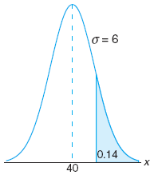
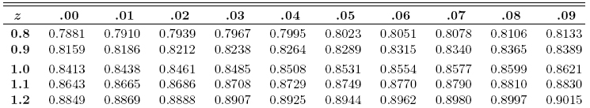
Chapter 6.3
Areas Under the Normal Curve
Area Under the Normal Curve
Given a normal distribution with μ = 40 and σ = 6, find the value of x that has (a) 45% of the area to the left, and (b) 14% of the area to the right.

Slide 7
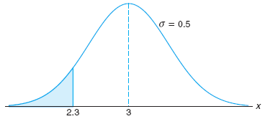
Chapter 6.4
Applications of the Normal Distribution
Applications of the Normal Distribution
A certain type of storage battery lasts, on average, 3.0 years, with a standard deviation of 0.5 year. Assuming that the battery lives are normally distributed, find the probability that a given battery will last less than 2.3 years.

Slide 8
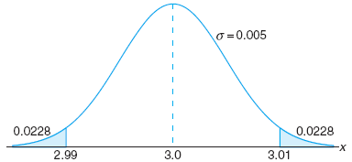
Chapter 6.4
Applications of the Normal Distribution
Applications of the Normal Distribution
In an industrial process the diameter of a ball bearing is an important component part. The buyer sets specifications on the diameter to be 3.0 ± 0.01 cm. All parts falling outside these specifications will be rejected.
It is known that in the process the diameter of a ball bearing has a normal distribution with mean 3.0 and standard deviation 0.005.
On the average, how many manufactured ball bearings will be scrapped?

Slide 9
Chapter 6.4
Applications of the Normal Distribution
Applications of the Normal Distribution
A certain machine makes electrical resistors having a mean resistance of 40 Ω and a standard deviation of 2 Ω. It is assumed that the resistance follows a normal distribution.
What percentage of resistors will have a resistance exceeding 43 Ω if:
the resistance can be measured to any degree of accuracy.
the resistance can be measured to the nearest ohm only.
As many as 6.68%–4.01% = 2.67% of the resistors will be accepted although the value is greater than 43 Ω due to measurement limitation

Slide 10
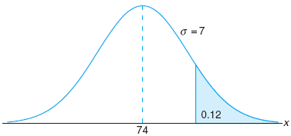
Chapter 6.4
Applications of the Normal Distribution
Applications of the Normal Distribution
The average grade for an exam is 74, and the standard deviation is 7. If 12% of the class are given A’s, and the grade are curved to follow a normal distribution, what is the lowest possible A and the highest possible B?
Lowest possible A is 83
Highest possible B is 82

Slide 11
Probability and Statistics
Homework 7A
Suppose the current measurements in a strip of wire are assumed to follow a normal distribution with a mean of 10 milliamperes and a variance of 4 milliamperes². (a) What is the probability that a measurement will exceed 13 milliamperes? (b) Determine the value for which the probability that a current measurement is below this value is 98%. (Mo.E4.13-14 p.113)
A lawyer commutes daily from his suburban home to midtown office. The average time for a one-way trip is 24 minutes, with a standard deviation of 3.8 minutes. Assume the distribution of trip times to be normally distributed. (a) If the office opens at 9:00 A.M. and the lawyer leaves his house at 8:45 A.M. daily, what percentage of the time is he late for work? (b) Find the probability that 2 of the next 3 trips will take at least 1/2 hour. (Wa.6.15 s.186)

